Slide 1
Dynamic Process Migration in Agent-Based Simulation
Miami University Simulation Environment
Paul Bondurant

Slide 2
Introduction
Discrete-Event Simulation (DES) has become an increasingly popular tool in fields such as ecology, biology, and social science.
Often, it is hard to create models to accurately represent the interactions within a complex system.
Agent-based DES is a useful tool creating simulations that don’t rely on models with an underlying equation.

Slide 3
Agent-Based Simulation
Comprised of individuals which behave autonomously
Keeps large simulations relatively simple while maintaining accuracy
Limited only by the imagination of the programmer

Slide 4
Main Components
Agents
“Players” in the simulation, drive the outcomes
Events
Interaction between agents
Messages
States
Track the changes in the agents
Used to formulate statistics

Slide 5
Agents
Created at initialization
Can be people, objects, areas, etc…….
Interact using “events” which are messages that agents send between each other
Each agent has a corresponding state
The current state of each agents affects the reaction the agents have at receiving any event

Slide 6
A Simple Interaction
Agent 2
Agent 1 State
Event 2
Agent 1
Agent 2 State
Event 1

Slide 7
Events
All events have an Agent ID which acts as an address for the event, a location in memory
All events also have a given time stamp which says when the event was sent
MUSE uses Time Warp to ensure the events occur in order

Slide 8
Time Warp
Since the simulation runs in parallel, all the agents have their own internal clock, so each agent may be at different points in time.
Time warp makes sure that if an event sent from one agent occurs in the past for another, time is turned backwards for the agent receiving the message and its state is updated in the correct order.
This complex algorithm keeps the system from having to keep track a list of all the messages ever sent in memory cutting back on resource usage.

Slide 9
Time Warp (cont.)
Each agent is its own Logical Process (LP) with an internal clock
Each agent has three queues:
Input queue – messages sent from other agents
Output queue – messages to other agents
State queue – saved states of the agent
If a straggler message/event occurs, time is rewound to the point of that message then the agent adjusts accordingly if it needs updating.

Slide 10
Time Warp in action
LVT
25
15
Input
11
11
12
15
16
20
24
Output
12
12
15
15
16
16
19
19
20
20
25
25
State
11
12
13
14
14
20
21
24

Slide 11
Mattern GVT Algorithm
To avoid massive amounts of memory use from three queues for every agent, older items are deleted from the queue if they are earlier than the Global Variable Time—the latest time for any agents.
An “initiator” agent sends a message/event to agent 1 called a “cut”. Agent 1 sends it to agent 2, 2 to 3, and so forth.
When the “cut” gets back to the “initiator”, the Global Variable Time is updated to the time of the “cut” message.

Slide 12
Introduction to MUSE
Developed by Meseret Radae Gebre for a Master’s thesis for Miami University in 2009
A parallel agent-base simulation environment
Written in C++ as oppose to Java for its faster matrix multiplication and communication execution times

Slide 13
Research
Need to improve MUSE simulation speed and efficiency
Goal: Cut down on the amount of rollbacks which are caused by event messages being sent from the past
Solution: add Dynamic Process Migration

Slide 14
How to Test Progress
Develop a simulation in which an increase in size (number of agents), increases the number of potential rollbacks exponentially

Slide 15
Cue RescueSim
Imagine a simple situation where in a 2-Dimentianal Environment there are scattered hidden, stationary “victims”
The objective is for mobile “volunteers” to find and “rescue” them
The key here is the range of sight and communication is limited, so only agents within range of each other can send events to each other

Slide 16
Main Components
Victims
Volunteers
Environment (Area agents)

Slide 17
Environment
The 2-D disaster area is divided into equal parts with each being assigned its own agent
Each environment agent is its own entity and doesn’t communicate with any others

Slide 18
Volunteers
Roam semi-randomly
Periodically reports current location to the Environment agents
Receives a list of volunteers and victims that are in a predetermined range (line of sight)
Sends a “report” to all nearby volunteers which is that list

Slide 19
Graphical Representation

Slide 20
Event Networks

Slide 21
Biggest Issues
The movement of the volunteers is random and isn’t intelligent which may cause long unnecessary runs
The simulation ends after a preset time rather than meeting a condition. Sometime not all simulations will result in all victims being found, and some will find all the victims well before the set end time
Ultimately, none of these issues affect the underlying issue of finding a good simulation to test for a large number of rollbacks

Slide 22
Test Results of RescueSim

Slide 23
Solution to Rollback Reduction
Rollbacks are caused by slower agents communicating with faster ones.
Agents on the same node run at about the same speed.
If agents that communicate often are on the same node, the number of rollbacks can be reduced.
Because it cannot be predicted which agents will communicate with each other more than others, the best way to have agents on the same node is to dynamically move the agents onto the same node.

Slide 24
Process Migration
Moving a process from one node to another.
In MPI, it must account for two levels:
The synchronization and coordination mechanisms within the MPI jobs
Incremental update support at the process/MPI task level
Both of these tasks can be handled live, and there exists algorithms that do such

Slide 25
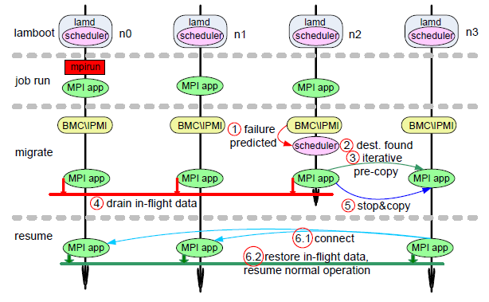
Job Live Migration

Slide 26
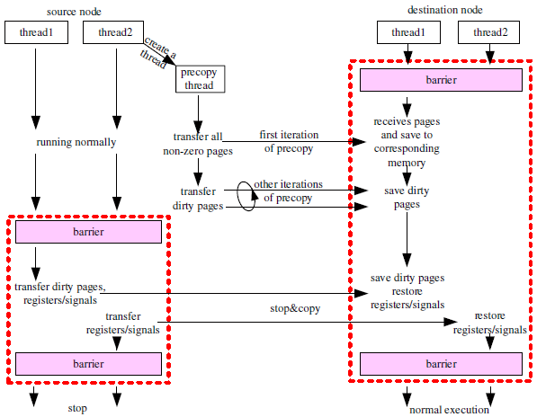
Live Migration at the Process Level

Slide 27
Adapting to MUSE
The goals of the research:
Synchronization with the TimeWarp
Keeping down memory usage
Handling Events in transit

Slide 28
Timeline

Slide 29
Bibliography
Fujimoto, R. M. (1989). Parallel Discrete Event Simulation. In E. A. . MacNair, K. J. . Musselman, & P. Heidelberger (Eds.), WSC Proceedings of the 21st conference on Winter simulation (pp. 19–28). Atlanta, GA: ACM. Retrieved from http://delivery.acm.org.proxy.lib.muohio.edu/10.1145/80000/76741/p19-fujimoto.pdf?ip=134.53.24.2&acc=ACTIVE SERVICE&CFID=151092536&CFTOKEN=14295089&__acm__=1346695915_adb5c3cacdbe6262b23c8ba8d87c9e79
Ji, D. S. M., Douglis, F., Paindaveine, Y., Wheeler, R., & Zhou, S. (2001). Process Migration, 32(3), 241–299.
Steinman, J. S. (1993). Breathing Time Warp. In R. Bagrodia & D. Jefferson (Eds.), PADS Proceedings of the seventh workshop on Parallel and Distributed Simulation (pp. 109–118). Pasadena, CA: ACM. Retrieved from http://delivery.acm.org.proxy.lib.muohio.edu/10.1145/160000/158473/p109-steinman.pdf?ip=134.53.24.2&acc=ACTIVE SERVICE&CFID=151092536&CFTOKEN=14295089&__acm__=1346697851_af522e0c9a0ed2ccfd1287631d32893a
Wang, C., Mueller, F., Engelmann, C., & Scott, S. L. (2008). Proactive Process-Level Live Migration in HPC Environments, (November).

Slide 30
Questions?

